Slide 1


Battle of the Neighborhoods – Singapore Best Neighborhood for Living
Coursera IBM Data Science Capstone Submission
By: Hao Z.
April 9, 2020

Slide 2
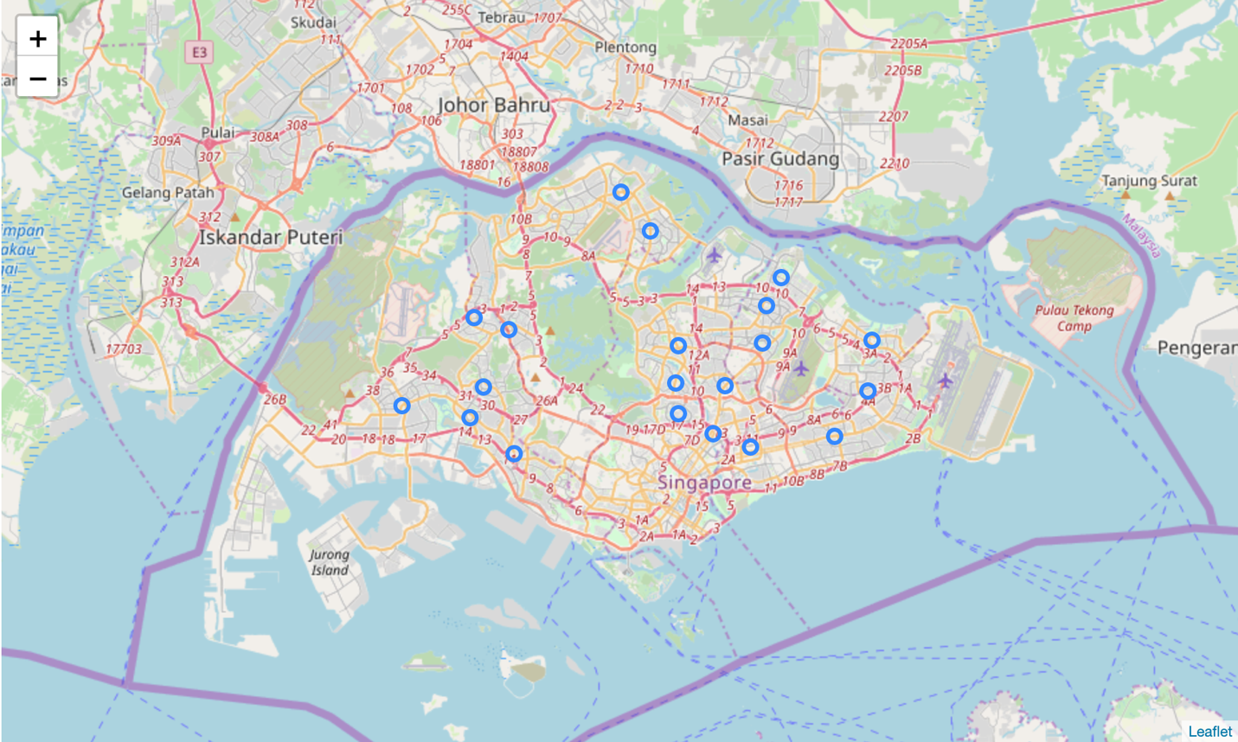
Background Information
Singapore is a city-state country located off the southern tip of the Malaysian peninsula.
Neighborhoods:
Bukit Batok
Bedok
Bishan
Bukit Merah
Bukit Panjang
Bukit Timah
Choa Chu Kang
Clementi
Central Area
Geylang
Hougang
Jurong East
Jurong West
Kallang/Whampoa
Marine Parade
Punggol
Pasir Ris
Queenstown
Sembawang
Serangoon
Sengkang
Tampines
Tengah
Toa Payoh
Woodlands
Yishun

Slide 3
Problem:
to analyze which neighborhood in Singapore is the most suitable for a middle-income family, based on the following criteria and weighted matrix:
Category | Housing Price | School | Restaurants | Living Essentials | Leisure
Weight (%) | 35% | 15% | 10% | 25% | 15%

Slide 4
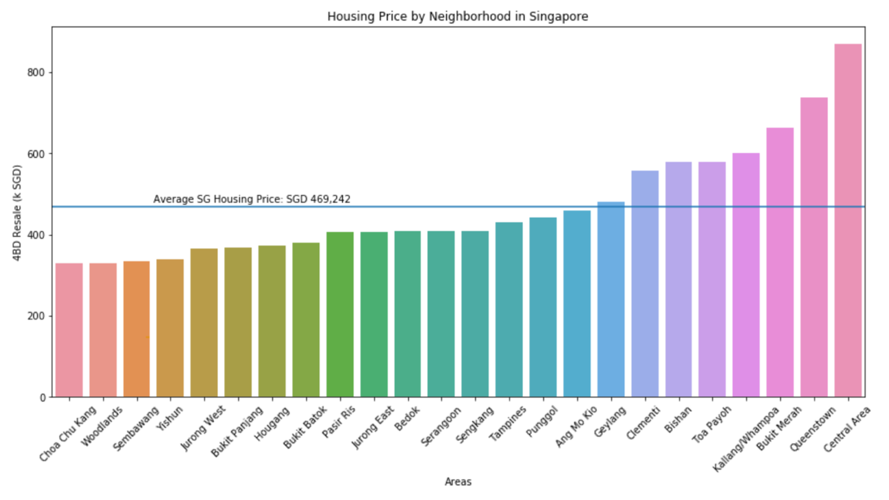
Housing Price
Based on 4 Bedroom HDB apartment prices by neighborhood
Average price: 467k SGD
1/3 neighborhoods above average
2/3 neighborhoods below average
Neighborhoods closest to average:
Punggol
Ang Mo Kio
Geylang
Data Sources: Asia One; Government of Singapore

Slide 5
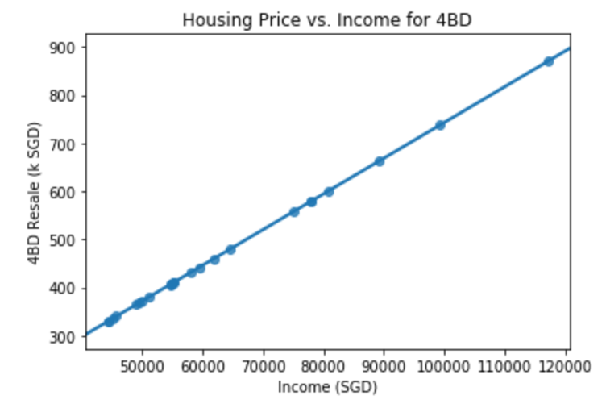
Trends in Housing
Linear dependency between income and apartment resale price
Positive correlation
Data Sources: Asia One; Government of Singapore

Slide 6
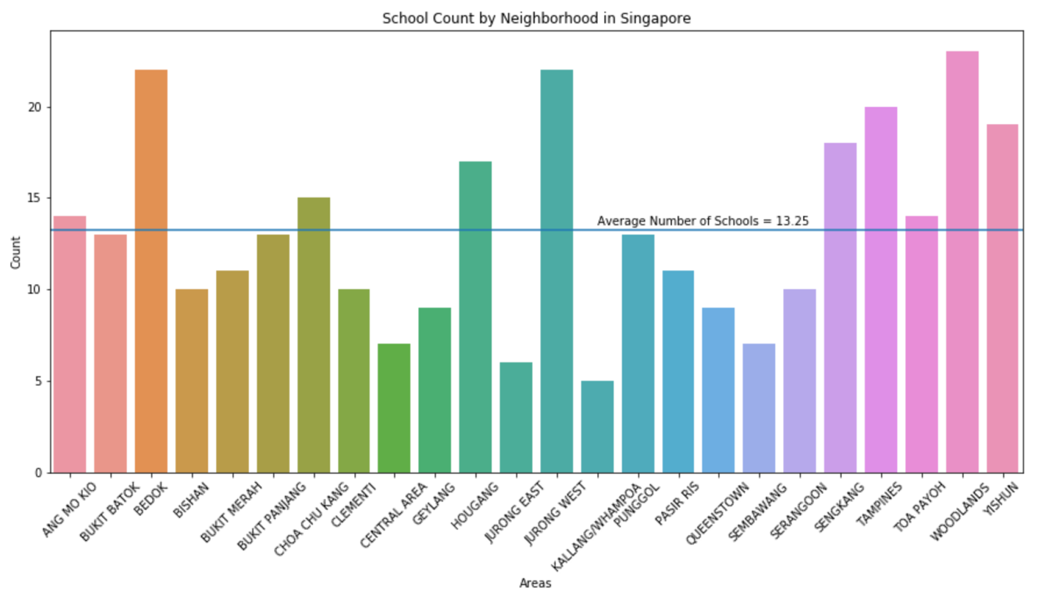
School Count
Accounts for both private and independent data collected by the Ministry of Education
Average schools per neighborhood: 13.25
Large fluctuations between neighborhoods
Data Sources: Government of Singapore

Slide 7
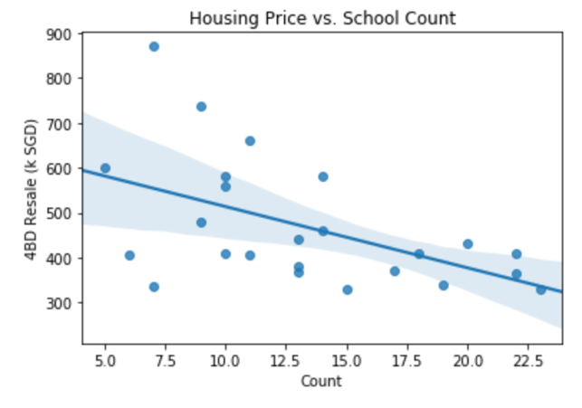
School Trend
Housing price decreases with increased number of schools: inversely proportional
Large deviations
Possible explanation: only large four-bedroom apartments are studied
Data Sources: Asia One; Government of Singapore

Slide 8
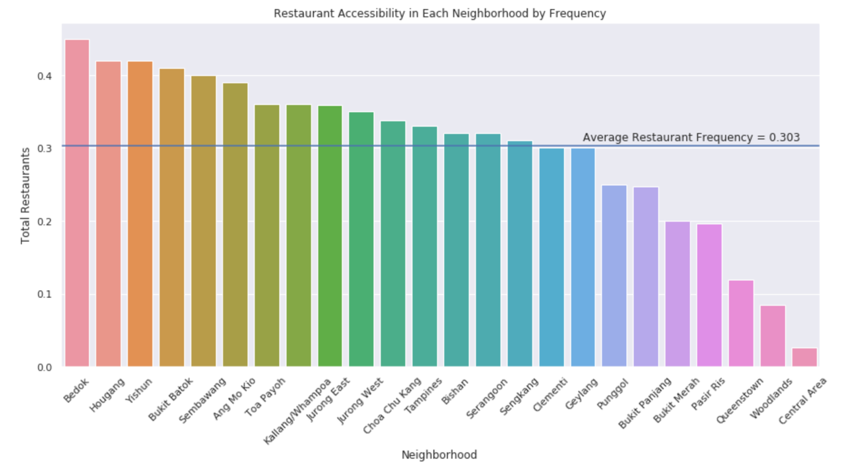
Access to Restaurants
Based on venue data entered on Foursquare
Restaurant types based on popularity, and include the following:
Food Court
Cafe
Chinese Restaurant
Fast Food Restaurant
Indian Restaurant
Japanese Restaurant
Asian Restaurant
Coffee Shop
The frequency of each type within the neighborhood is studied
Most of the communities have great access to restaurant facilities
Data Sources: Foursquare

Slide 9
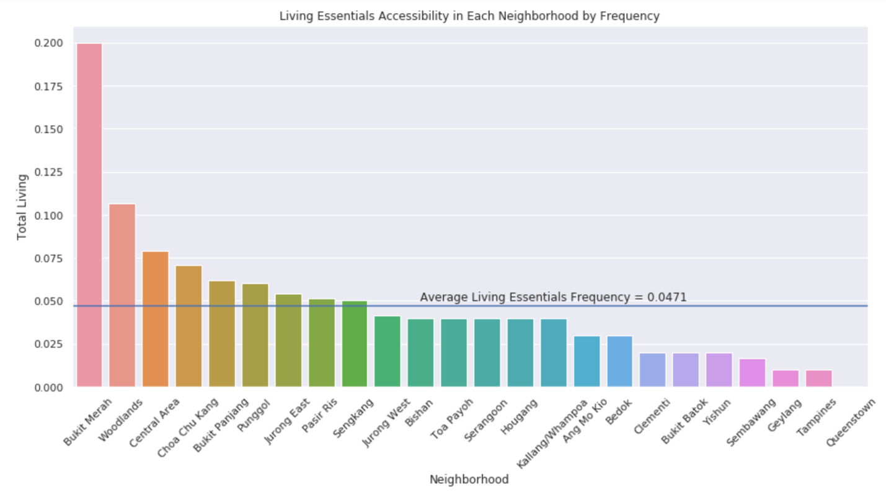
Access to Stores with Living Essentials
Based on venue data entered on Foursquare
Store types include:
Grocery stores
Pharmacies
Convenience stores
The frequency of each type within the neighborhood is studied
1/3 of the communities do not have good access to stores
Data Sources: Foursquare

Slide 10
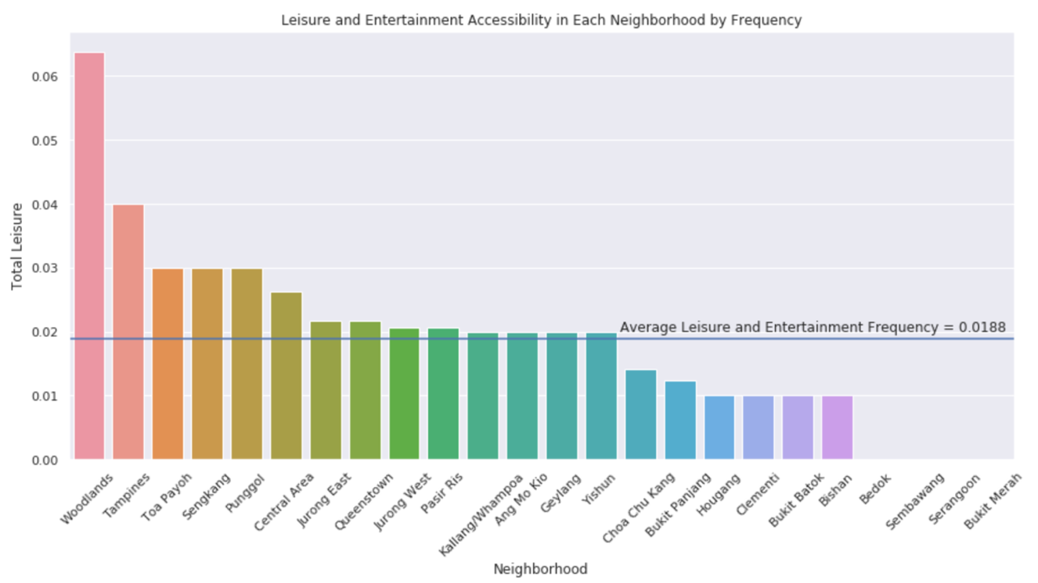
Access to Leisure and Entertainment Facilities
Based on venue data entered on Foursquare
Venue types include:
Gym
Theatre
Zoo
Park
The frequency of each type within the neighborhood is studied
1/5 of the neighborhoods either have no data or have limited access to facilities
Data Sources: Foursquare

Slide 11
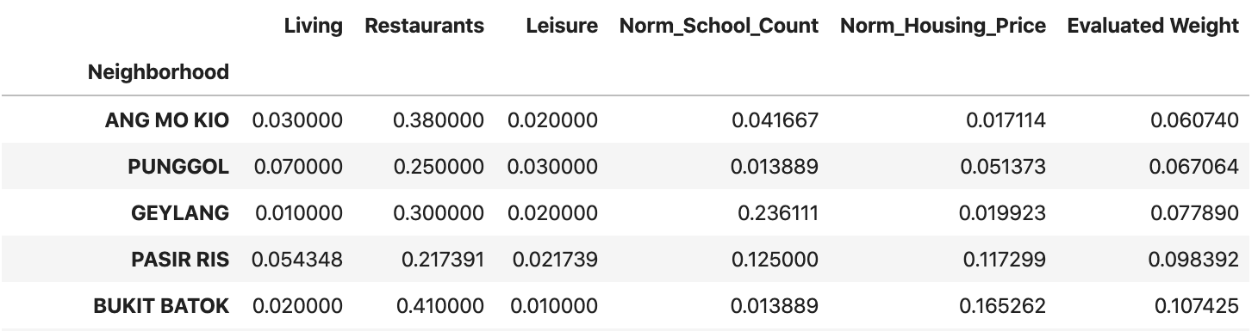
Top Five Neighborhoods Using Weighted Matrix
Ang Mo Kio
Punggol
Geylang
Pasir Ris
Bukit Batok
The matrix has been calculated using absolute values of normalized school counts and normalized housing price. The minimum weight is deemed to be the best neighborhood as the housing affordability is critical in this research, and minimum scoring ensures that housing price is close to the average price.

Slide 12

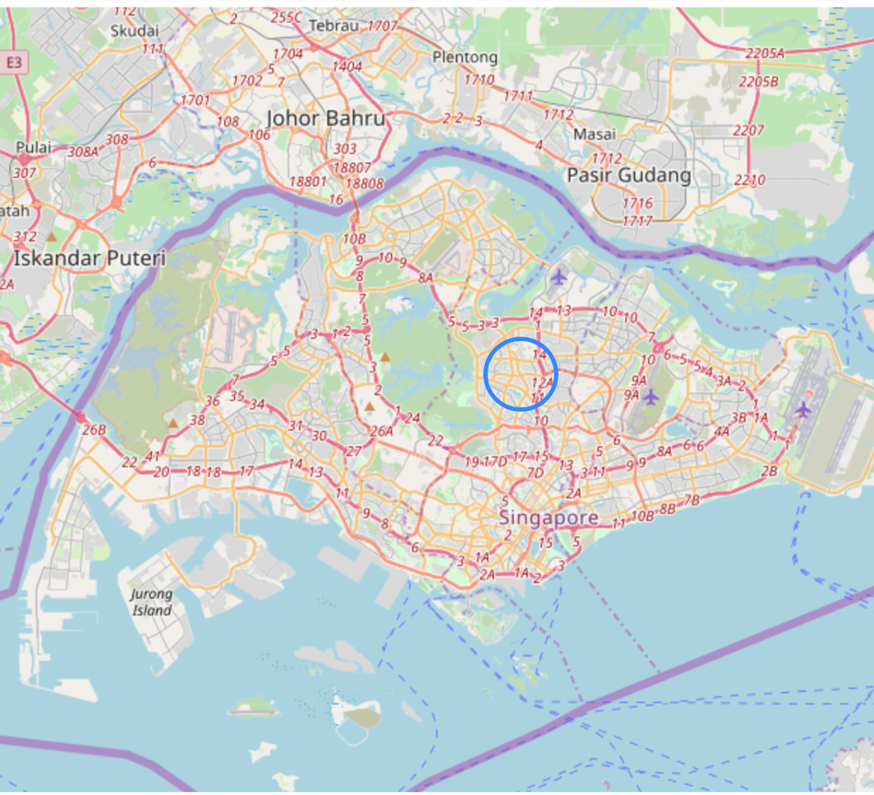
Best Neighborhood: Ang Mo Kio
Housing price closest to average
Average score for access to leisure facilities and in terms of school count
Above-average performance for restaurants
Slightly below average access to stores with living essentials

Slide 13
Limitations to This Study
No transportation data incorporated;
Only certain categories of venues have been included in the research;
Heavily relies on the availability and accuracy of data retrieved from Foursquare
For future investigations:
Include more categories of venues;
Include data from other aspects, such as crime and vandalism, transportation.

Slide 14
Thank You!

